Slide 1
Domain Name Servers (DNS)
CPSC 3600

Slide 2
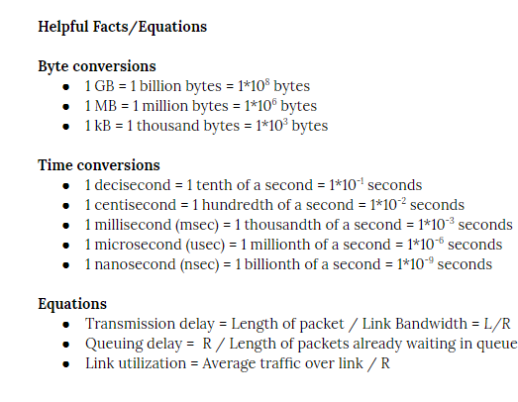
First Exam
12 questions
6 short answer
2 code analysis
4 computation

Slide 3
DNS: Domain Name System
Websites have two types of identifiers
Hostnames/URLs
IP Address
Equivalent to people
Names, SSN, passport #, etc
Internet needs a system that maps URLs to IP Addresses
Routers need to use IP Addresses (remember lookup tables)
Easy to remember google.com, hard to remember 216.239.32.0
Same URL can be mapped to multiple IP addresses, in the event that a single website is hosted on multiple servers

Slide 4
DNS Process
Two components to the DNS service
A distributed, hierarchical database containing the recorded mappings between hostname and IP addresses
An application-layer protocol that can query this database
Application protocol runs on port 53, using UDP

Slide 5
DNS Process
User inputs a URL/hostname
Client host queries a DNS client about the hostname (most likely running on the host, e.g. in your browser)
DNS application sends a query to a DNS server
DNS client eventually receives a reply including IP address
Returns this to the host application that originated request

Slide 6
DNS Cache
DNS requests can add considerable delay, as the DNS server may have to query other servers to find the correct IP address
DNS servers will cache new IP addresses to shorten future requests and reduce overall Internet load

Slide 7
Other Services
Host aliasing
Hostnames can have aliases, alternative representations
E.g. clemson.edu vs. www.clemson.edu
Mail server aliasing
Email servers can also have aliases
E.g. bob@yahoo.mail vs. bob@relay1.west-coast.yahoo.com
Load distribution
Large sites are hosted on multiple servers, each with unique IPs
DNS servers rotate through the IP address given back to clients to help balance load across the servers

Slide 8
Distributed Database
Many different DNS servers scattered across the world, each hosting portions of the distributed database
Removes single point of failure
Handles large amounts of traffic volume
“Close” to all clients
Easier to maintain individual databases

Slide 9
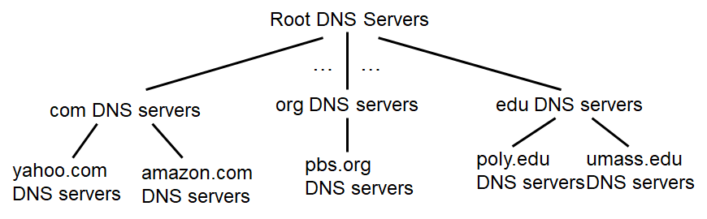
Hierarchical DNS Servers
Three classes of DNS servers, ordered in a hierarchy
Root DNS servers
Top-level domain (TLD) DNS servers
Authoritative servers

Slide 10
Root DNS Servers
If a local DNS server doesn’t know a mapping, it contacts a Root DNS server
13 different root servers, each replicated many times
Root name server
Returns name mapping if known
If not, returns address of an appropriate TLD server to request

Slide 11
2. TLD DNS servers
TLD DNS servers manage “top-level” domains
E.g. .com, .edu., .gov, .us, .fr, .jp, …
Different companies manage different TLDs
E.g. Verisign manages .com, Educause manages .edu
Ideally TLD server sends client address of Authoritative DNS server than knows the actual IP address
E.g. TLD .edu server send you to dns.clemson.edu
May be other levels in the hierarchy though
E.g. TLD .edu → dns.clemson.edu → dsn.clemson.cs.edu

Slide 12
3. Authoritative DNS servers
Authoritative DNS servers are where the mapping between hostnames and IP addresses are stored
Unless the mapping has been cached higher up
Organizations run their own authoritative DNS servers
Alternatively, you can register your own hostname with an authoritative DNS server (e.g. godaddy)
Once the request gets to this level, the client will get the IP address it is looking for

Slide 13
~0. Local Domain Server
There are also local domain servers, owned/operated by ISPs, companies, universities, etc
These don’t strictly belong in the hierarchy, but are where hosts first send requests to
The local domain server acts as a:
Cache
Proxy server that forwards requests into the hierarchy

Slide 14
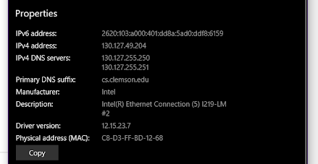

Slide 15
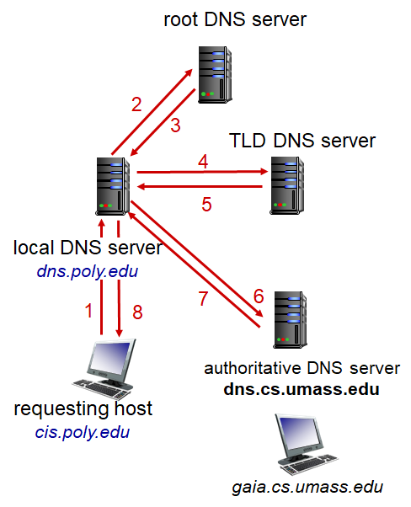
DNS Query count
DNS queries sent over UDP
Multiple queries required, can be:
Iterative

Slide 16
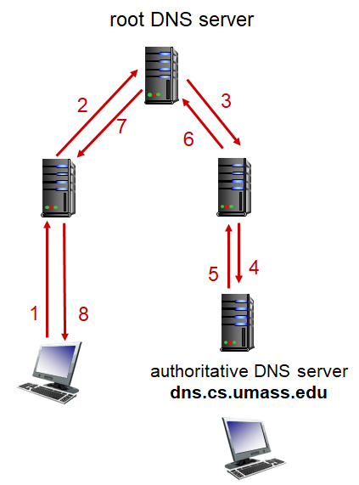
DNS Query count
DNS queries sent over UDP
Multiple queries required, can be:
Iterative
Recursive

Slide 17
DNS Query count
DNS queries sent over UDP
Multiple queries required, can be:
Iterative
Recursive
Same time requirement

Slide 18
DNS Caching
DNS servers can cache hostname-IP mappings to speed up the request process
Typically cached for ~2 days, then released
Can also cache connections to TLD servers, bypassing root DNS servers
Caches can be out of date! Domain names remapped to different IP, won’t be known Internet wide till TTLs expire
Why it takes a few days for a hostname registration to propagate

Slide 19
DNS Records (RRs)
Each entry in a DNS database follows the same pattern
(Name, Value, Type, TTL)
TTL is the time to live in the cache
Type determines what Name and Value mean
Type=A → Authoritative, Name=hostname, Value=IP Address
Type=NS → Name = domain, Value = hostname of auth. DNS server
Type=CNAME → Name = alias hostname, Value = canonical hostname
Type=MX → Name = alias email hostname, Value = canonical hostname

Slide 20
DNS Message
Not human readable, unlike HTTP messages
Query and reply messages use the same format, unlike HTTP

Slide 21
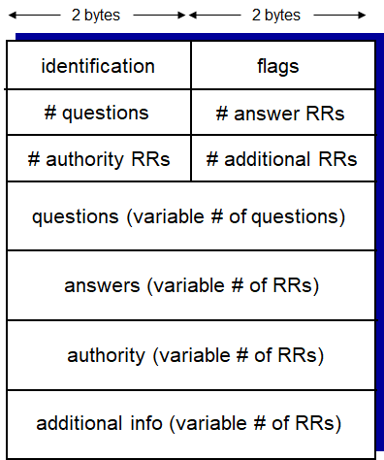
DNS Message
12 bytes for header section
ID number, allows clients to match response to requests
Multiple one-bit flags
Length of different payloads also listed there

Slide 22
DNS Message
Flags
Query or reply
Recursion desired
Recursion available
Reply is authoritative

Slide 23
DNS Message
Questions:
name, type fields for a query
Answers
RR in response to query
Authority:
Records for authoritative servers
Additional info
Other “helpful” information

Slide 24
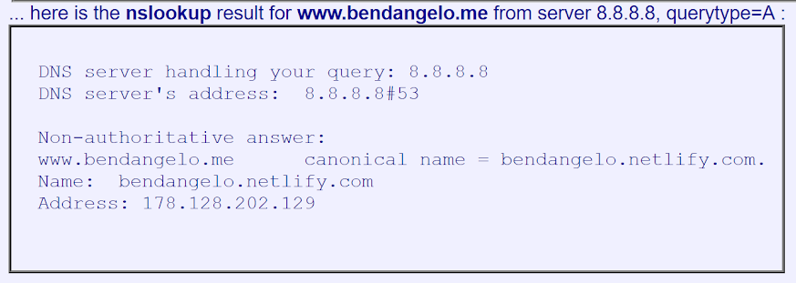
nslookup
Program nslookup lets you send a DNS query message
Available online, or in a terminal

Slide 25
Inserting RRs into DNS Database
How do you add completely new records?
Register your domain name at a registrar, commercial entities that verify uniqueness of new hostnames and enters the domain name into a DNS database
You provide the registrar with your primary and secondary authoritative DNS servers (provided by hosting service)
Type NS and A records are then added to the appropriate TLD servers
(networkutopia.com, dns1.networkutopia.com, NS)
(dns1.networkutopia.com, 212.212.212.1, A)

